Slide 1
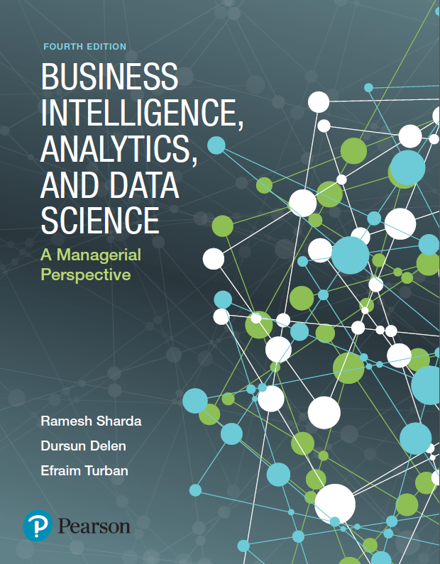
Business Intelligence, Analytics, and Data Science: A Managerial Perspective
Fourth Edition
Chapter 2
Descriptive Analytics I: Nature of Data, Statistical Modeling, and Visualization
Slides in this presentation contain hyperlinks. JAWS users should be able to get a list of links by using INSERT+F7
Copyright © 2018, 2014, 2011 Pearson Education, Inc. All Rights Reserved
Notes:
If this PowerPoint presentation contains mathematical equations, you may need to check that your computer has the following installed:
1) MathType Plugin
2) Math Player (free versions available)
3) NVDA Reader (free versions available)

Slide 2
Learning Objectives (1 of 2)
2.1 Understand the nature of data as it relates to business intelligence (B I) and analytics
2.2 Learn the methods used to make real-world data analytics ready
2.3 Describe statistical modeling and its relationship to business analytics
2.4 Learn about descriptive and inferential statistics
2.5 Define business reporting, and understand its historical evolution
Notes:
Slide 2 is a list of textbook LO numbers and statements.

Slide 3
Learning Objectives (2 of 2)
2.6 Understand the importance of data/information visualization
2.7 Learn different types of visualization techniques
2.8 Appreciate the value that visual analytics brings to business analytics
2.9 Know the capabilities and limitations of dashboards
Notes:
Slide 3 is a list of textbook LO numbers and statements.

Slide 4
Opening Vignette
Attracts and Engages a New Generation of Radio Consumers with Data-Driven Marketing
What does Sirius X M do? In what type of market does it conduct its business?
What were the challenges? Comment on both technology and data-related challenges.
What were the proposed solutions?
How did they implement the proposed solutions? Did they face any implementation challenges?
What were the results and benefits? Were they worth the effort/investment?

Slide 5
The Nature of Data (1 of 2)
Data: a collection of facts
usually obtained as the result of experiences, observations, or experiments
Data may consist of numbers, words, images, …
Data is the lowest level of abstraction (from which information and knowledge are derived)
Data is the source for information and knowledge
Data quality and data integrity → critical to analytics

Slide 6
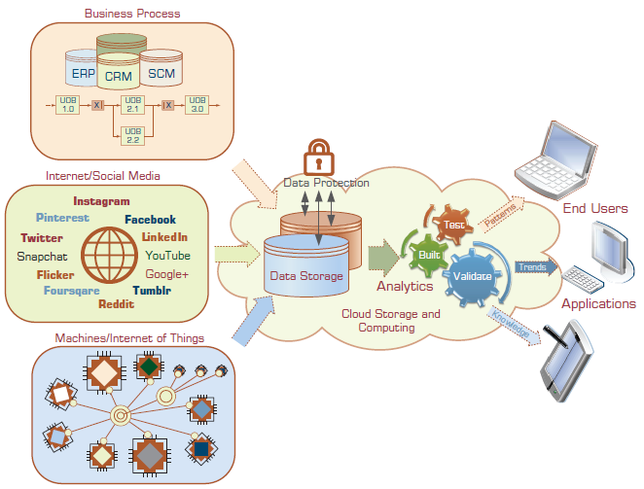
The Nature of Data (2 of 2)

Slide 7
Metrics for Analytics Ready Data
Data source reliability
Data content accuracy
Data accessibility
Data security and data privacy
Data richness
Data consistency
Data currency/data timeliness
Data granularity
Data validity and data relevancy

Slide 8
A Simple Taxonomy of Data (1 of 2)
Data (datum—singular form of data): facts
Structured data
Targeted for computers to process
Numeric versus nominal
Unstructured/textual data
Targeted for humans to process/digest
Semi-structured data?
X M L, H T M L, Log files, etc.
Data taxonomy…

Slide 9
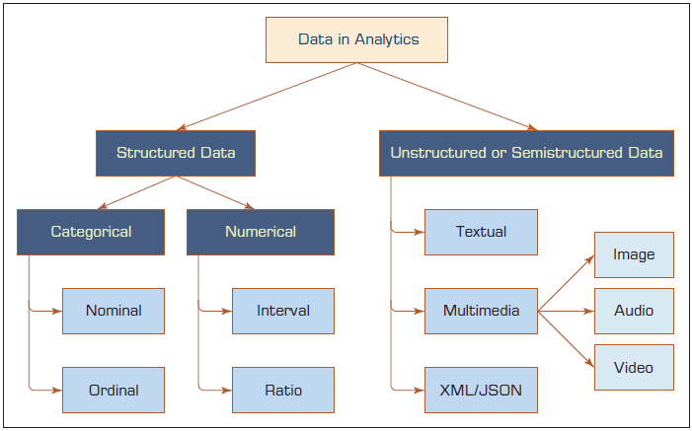
A Simple Taxonomy of Data (2 of 2)

Slide 10
Application Case 2.1
Medical Device Company Ensures Product Quality While Saving Money
Questions for Discussion
What were the main challenges for the medical device company? Were they market or technology driven?
What was the proposed solution?
What were the results? What do you think was the real return on investment (R O I)?

Slide 11
The Art and Science of Data Preprocessing (1 of 2)
The real-world data is dirty, misaligned, overly complex, and inaccurate
Not ready for analytics!
Readying the data for analytics is needed
Data preprocessing
Data consolidation
Data cleaning
Data transformation
Data reduction
Art – it develops and improves with experience

Slide 12
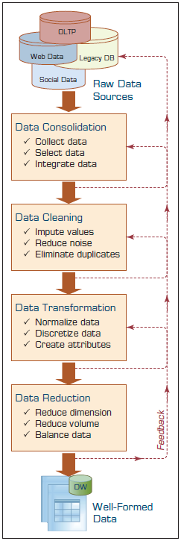
The Art and Science of Data Preprocessing (2 of 2)
Data reduction
1. Variables
Dimensional reduction
Variable selection
2. Cases/samples
Sampling
Balancing / stratification

Slide 13
Data Preprocessing Tasks and Methods (1 of 3)
Table 2.1 A Summary of Data Preprocessing Tasks and Potential Methods
Main Task | Subtasks | Popular Methods
Data consolidation | Access and collect the data Select and filter the data Integrate and unify the data | S Q L queries, software agents, Web services. Domain expertise, S Q L queries, statistical tests. S Q L queries, domain expertise, ontology-driven data mapping.
Data cleaning | Handle missing values in the data | Fill in missing values (imputations) with most appropriate values (mean, median, min/max, mode, etc.); recode the missing values with a constant such as “M L”; remove the record of the missing value; do nothing.
Data cleaning | Identify and reduce noise in the data | Identify the outliers in data with simple statistical techniques (such as averages and standard deviations) or with cluster analysis; once identified, either remove the outliers or smooth them by using binning, regression, or simple averages.

Slide 14
Data Preprocessing Tasks and Methods (2 of 3)
Main Task | Subtasks | Popular Methods
Data cleaning | Find and eliminate erroneous data | Identify the erroneous values in data (other than outliers), such as odd values, inconsistent class labels, odd distributions; once identified, use domain expertise to correct the values or remove the records holding the erroneous values.
Data transformation | Normalize the data | Reduce the range of values in each numerically valued variable to a standard range (e.g., 0 to 1 or -1 to +1) by using a variety of normalization or scaling techniques.
Data transformation | Discretize or aggregate the data | If needed, convert the numeric variables into discrete representations using range-or frequency-based binning techniques; for categorical variables, reduce the number of values by applying proper concept hierarchies.

Slide 15
Data Preprocessing Tasks and Methods (3 of 3)
Main Task | Subtasks | Popular Methods
Data transformation | Construct new attributes | Derive new and more informative variables from the existing ones using a wide range of mathematical functions (as simple as addition and multiplication or as complex as a hybrid combination of log transformations).
Data reduction | Reduce number of attributes | Principal component analysis, independent component analysis, chi-square testing, correlation analysis, and decision tree induction.
Data reduction | Reduce number of records | Random sampling, stratified sampling, expert-knowledge-driven purposeful sampling.
Data reduction | Balance skewed data | Oversample the less represented or undersample the more represented classes.

Slide 16
Application Case 2.2 (1 of 6)
Improving Student Retention with Data-Driven Analytics
Questions for Discussion
What is student attrition, and why is it an important problem in higher education?
What were the traditional methods to deal with the attrition problem?
List and discuss the data-related challenges within context of this case study.
What was the proposed solution? And, what were the results?

Slide 17
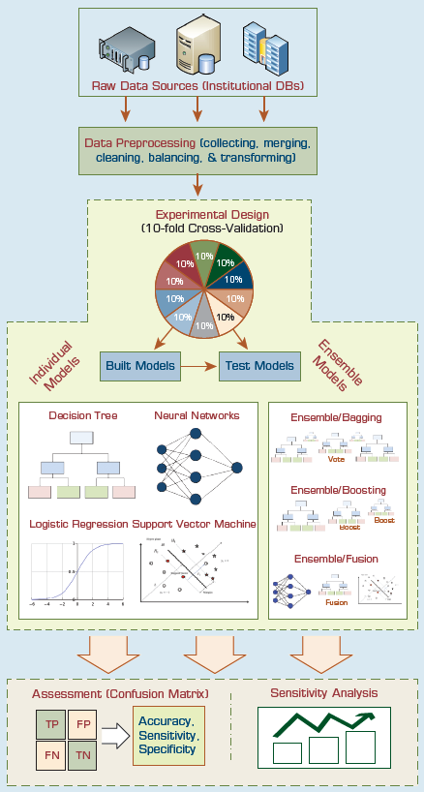
Application Case 2.2 (2 of 6)
Student retention
Freshmen class
Why it is important?
What are the common techniques to deal with student attrition?
Analytics versus theoretical approaches to student retention problem

Slide 18
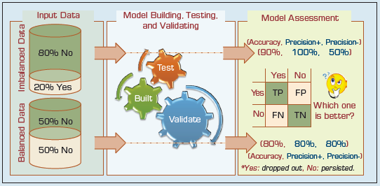
Application Case 2.2 (3 of 6)
Data imbalance problem

Slide 19
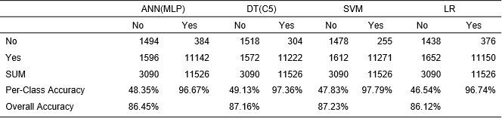
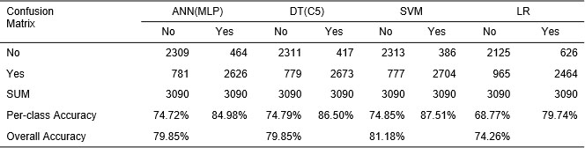
Application Case 2.2 (4 of 6)
Table 2.2 Prediction Results for the Original/Unbalanced Dataset
Table 2.3 Prediction Results for the Balanced Data Set

Slide 20
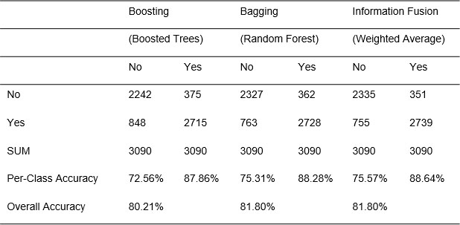
Application Case 2.2 (5 of 6)
Table 2.4 Prediction Results for the Three Ensemble Models

Slide 21
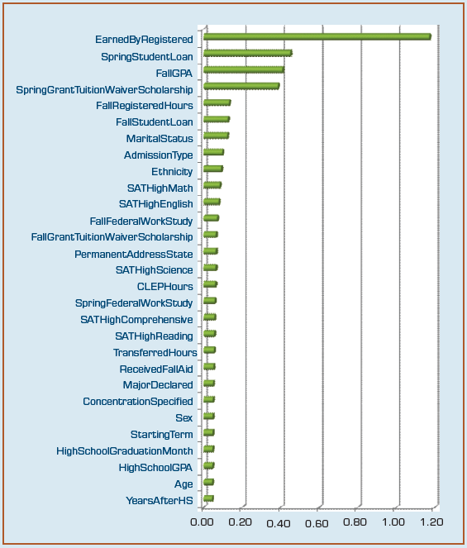
Application Case 2.2 (6 of 6)
Results...

Slide 22
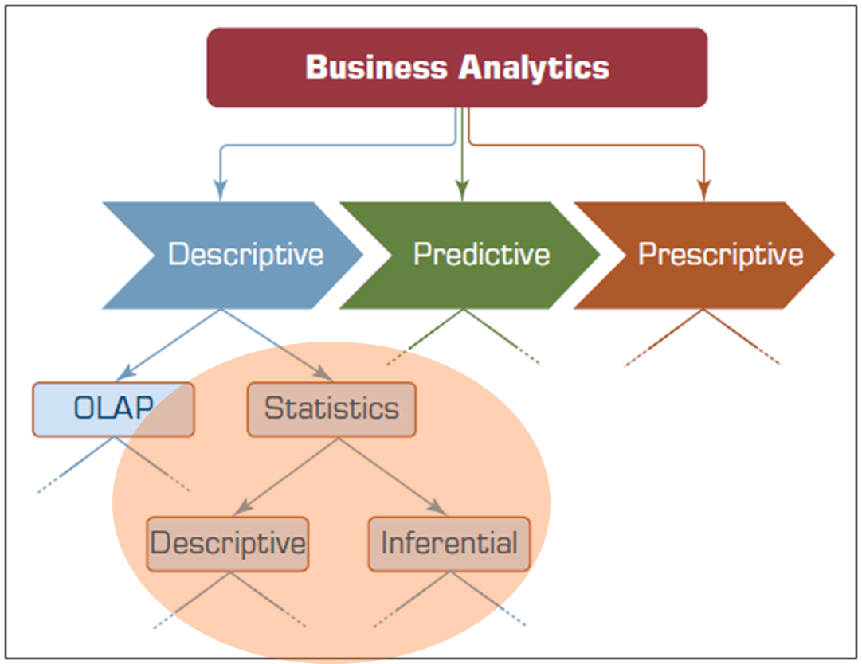
Statistical Modeling for Business Analytics (1 of 2)

Slide 23
Statistical Modeling for Business Analytics (2 of 2)
Statistics
A collection of mathematical techniques to characterize and interpret data
Descriptive Statistics
Describing the data (as it is)
Inferential statistics
Drawing inferences about the population based on sample data
Descriptive statistics for descriptive analytics

Slide 24
Descriptive Statistics Measures of Centrality Tendency
Arithmetic mean
Median
The number in the middle
Mode
The most frequent observation

Slide 25
Descriptive Statistics Measures of Dispersion (1 of 2)
Dispersion
Degree of variation in a given variable
Range
Max - Min
Variance
Standard Deviation
Mean Absolute Deviation (M A D)
Average absolute deviation from the mean

Slide 26
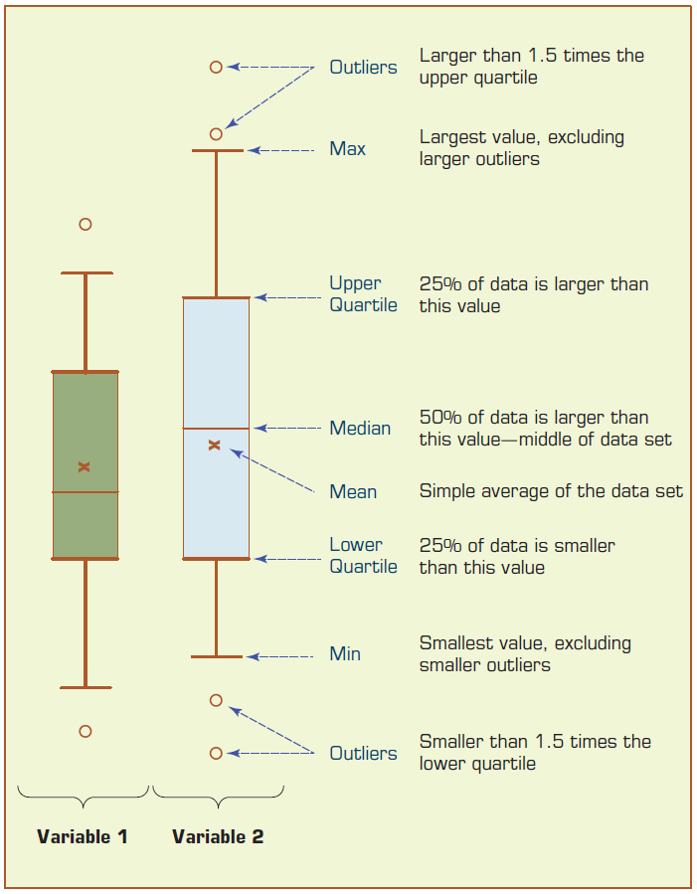
Descriptive Statistics Measures of Dispersion (2 of 2)
Quartiles
Box-and-Whiskers Plot
a.k.a. box-plot
Versatile / informative

Slide 27
Descriptive Statistics Shape of a Distribution
Histogram – frequency chart
Skewness
Measure of asymmetry
Kurtosis
Peak/tall/skinny nature of the distribution

Slide 28
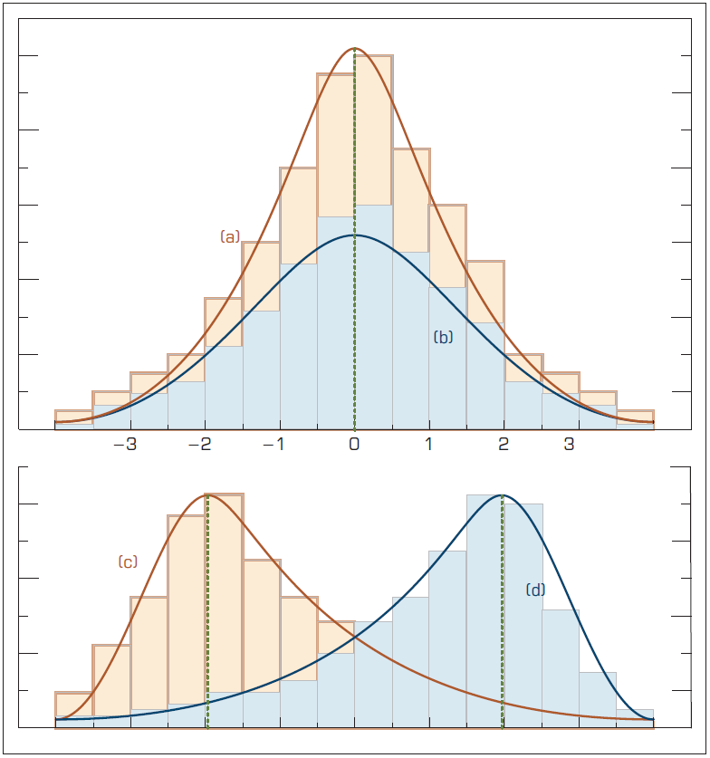
Relationship Between Dispersion and Shape Properties

Slide 29
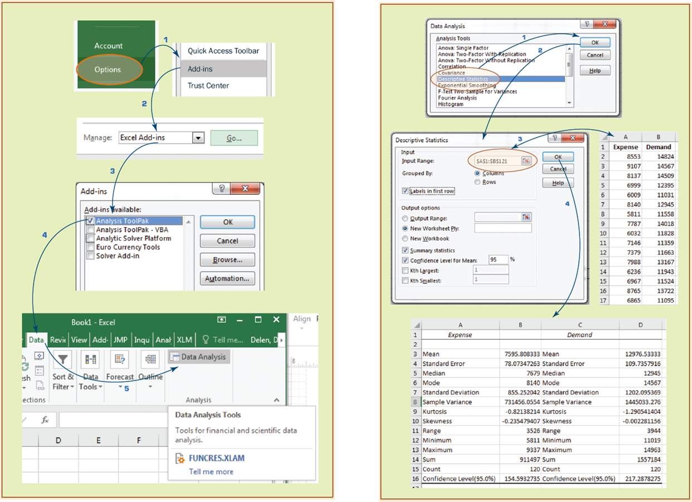
Technology Insights 2.1 (1 of 2)
Descriptive Statistics in Excel

Slide 30
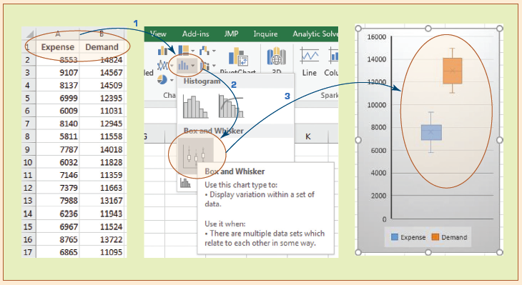
Technology Insights 2.1 (2 of 2)
Descriptive Statistics in Excel Creating box-plot in Microsoft Excel

Slide 31
Application Case 2.3
Town of Cary Uses Analytics to Analyze Data from Sensors, Assess Demand, and Detect Problems
Questions for Discussion
What were the challenges the Town of Cary was facing?
What was the proposed solution?
What were the results?
What other problems and data analytics solutions do you foresee for towns like Cary?

Slide 32
Regression Modeling for Inferential Statistics
Regression
A part of inferential statistics
The most widely known and used analytics technique in statistics
Used to characterize relationship between explanatory (input) and response (output) variable
It can be used for
Hypothesis testing (explanation)
Forecasting (prediction)

Slide 33
Regression Modeling (1 of 3)
Correlation versus Regression
What is the difference (or relationship)?
Simple Regression versus Multiple Regression
Base on number of input variables
How do we develop linear regression models?
Scatter plots (visualization—for simple regression)
Ordinary least squares method
A line that minimizes squared of the errors

Slide 34
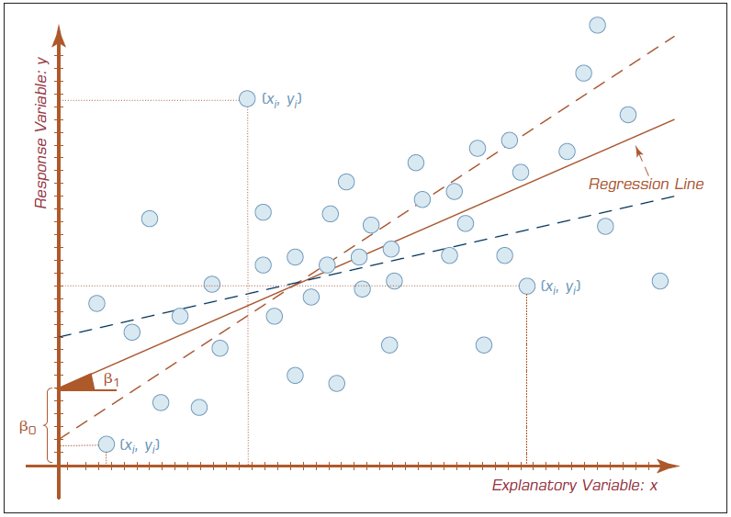
Regression Modeling (2 of 3)

Slide 35
Regression Modeling (3 of 3)
x: input, y: output
Simple Linear Regression
Multiple Linear Regression
The meaning of Beta
coefficients
Sign (+ or -) and magnitude

Slide 36
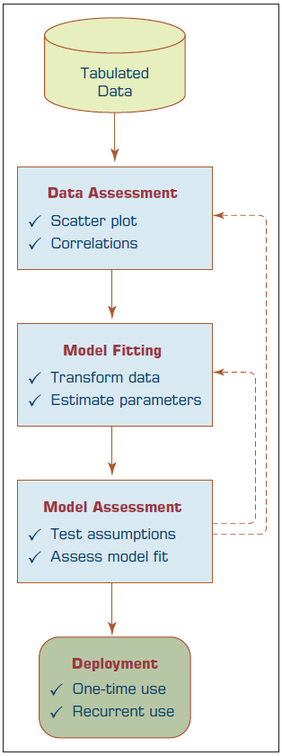
Process of Developing a Regression Model
How do we know if the model is good enough?
(R-Square)
p Values
Error measures (for prediction problems)
M S E, M A D, R M S E

Slide 37
Regression Modeling Assumptions
Linearity
Independence
Normality (Normal Distribution)
Constant Variance
Multicollinearity
What happens if the assumptions do Not hold?
What do we do then?

Slide 38
Logistic Regression Modeling (1 of 2)
A very popular statistics-based classification algorithm
Employs supervised learning
Developed in 1940s
The difference between Linear Regression and Logistic Regression
In Logistic Regression Output/Target variable is a binomial (binary classification) variable (as opposed to numeric variable)

Slide 39
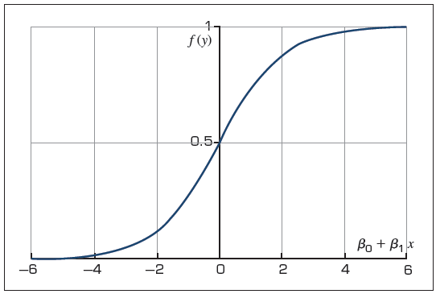
Logistic Regression Modeling (2 of 2)

Slide 40
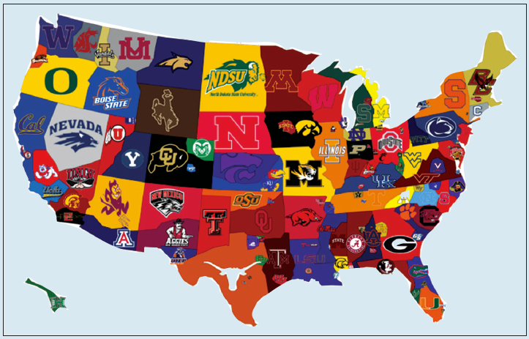
Application Case 2.4 (1 of 6)
Predicting N C A A Bowl Game Outcomes

Slide 41
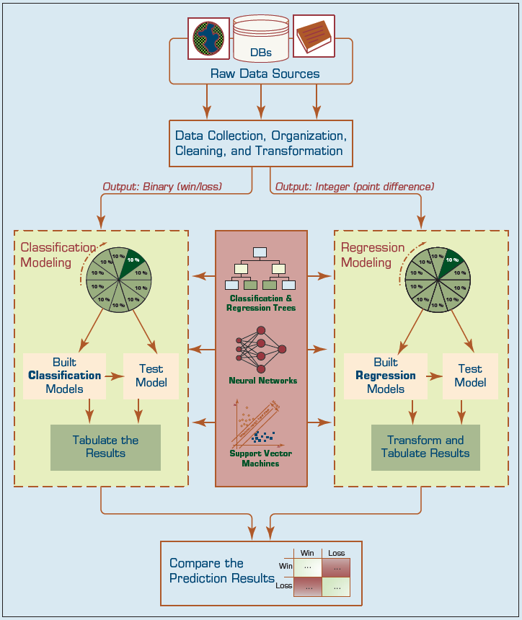
Application Case 2.4 (2 of 6)
The analytics process to develop prediction models (both regression and classification type) for N C A A Bowl Game outcomes

Slide 42
Application Case 2.4 (3 of 6)
Prediction Results
1. Classification
2. Regression

Slide 43
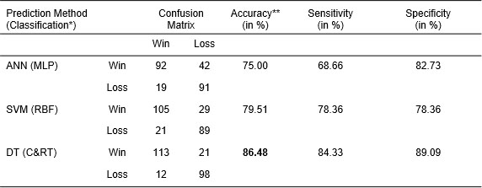
Application Case 2.4 (4 of 6)
Table 2.6 Prediction results for the direct classification methodology
*The output variable is a binary categorical variable (Win or Loss); differences were sig (** p < 0.01).

Slide 44
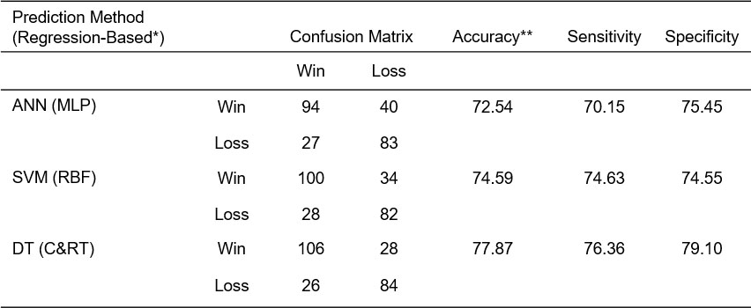
Application Case 2.4 (5 of 6)
Table 2.7 Prediction results for the regression-based classification methodology
*The output variable is a numerical/integer variable (point-diff); differences were sig (** p < 0.01).

Slide 45
Application Case 2.4 (6 of 6)
Questions for Discussion
What are the foreseeable challenges in predicting sporting event outcomes (e.g., college bowl games)?
How did the researchers formulate/design the prediction problem (i.e., what were the inputs and output, and what was the representation of a single sample—row of data)?
How successful were the prediction results? What else can they do to improve the accuracy?

Slide 46
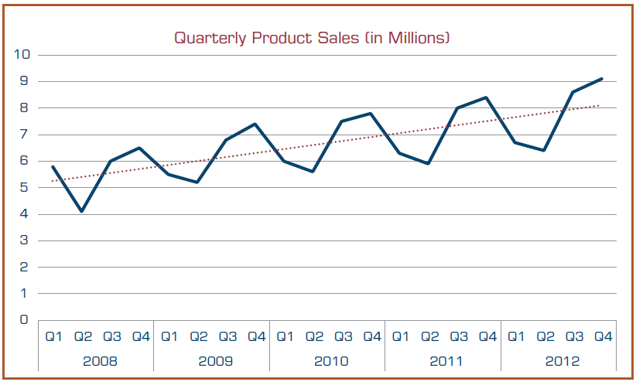
Time Series Forecasting
Is it different than Simple Linear Regression? How?

Slide 47
Business Reporting Definitions and Concepts
Report = Information → Decision
Report?
Any communication artifact prepared to convey specific information
A report can fulfill many functions
To ensure proper departmental functioning
To provide information
To provide the results of an analysis
To persuade others to act
To create an organizational memory…

Slide 48
What is a Business Report?
A written document that contains information regarding business matters.
Purpose: to improve managerial decisions
Source: data from inside and outside the organization (via the use of E T L)
Format: text + tables + graphs/charts
Distribution: in-print, email, portal/intranet
Data acquisition → Information generation → Decision making → Process management

Slide 49
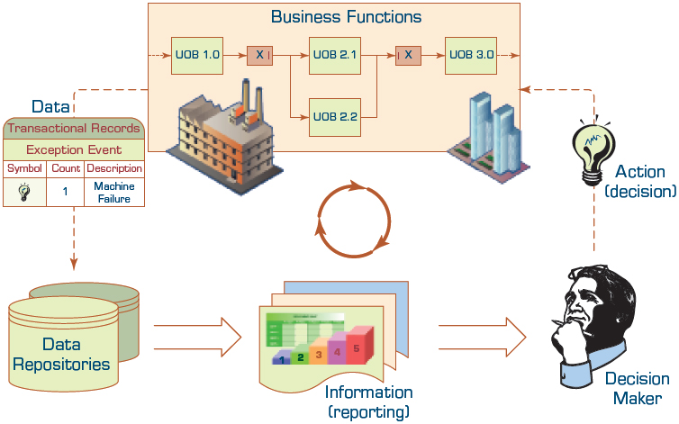
Business Reporting

Slide 50
Types of Business Reports
Metric Management Reports
Help manage business performance through metrics (S L A s for externals; K P I s for internals)
Can be used as part of Six Sigma and/or T Q M
Dashboard-Type Reports
Graphical presentation of several performance indicators in a single page using dials/gauges
Balanced Scorecard–Type Reports
Include financial, customer, business process, and learning & growth indicators

Slide 51
Application Case 2.5
Flood of Paper Ends at F E M A
Questions for Discussion
What is F E M A, and what does it do?
What are the main challenges that F E M A faces?
How did F E M A improve its inefficient reporting practices?

Slide 52
Data Visualization
“The use of visual representations to explore, make sense of, and communicate data.”
Data visualization vs. Information visualization
Information = aggregation, summarization, and contextualization of data
Related to information graphics, scientific visualization, and statistical graphics
Often includes charts, graphs, illustrations, …

Slide 53
A Brief History of Data Visualization
Data visualization can date back to the second century A D
Most developments have occurred in the last two and a half centuries
Until recently it was not recognized as a discipline
Today’s most popular visual forms date back a few centuries

Slide 54
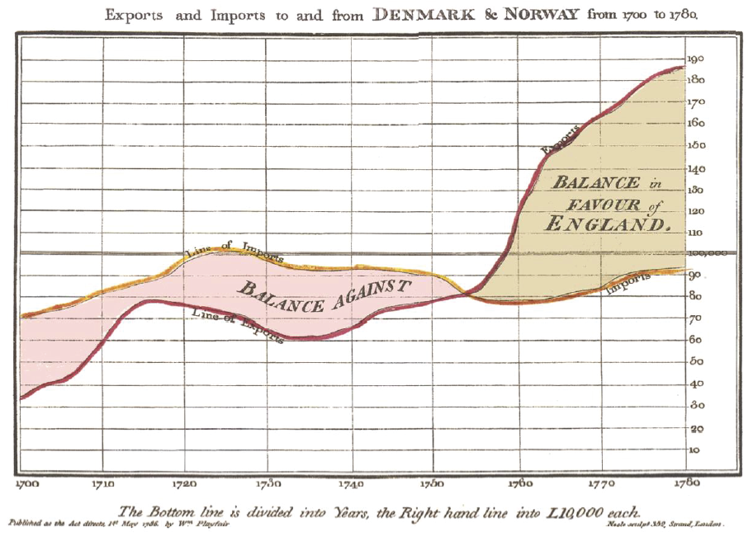
The First Pie Chart Created by William Playfair in 1801
William Playfair is widely credited as the inventor of the modern chart, having created the first line and pie charts.

Slide 55
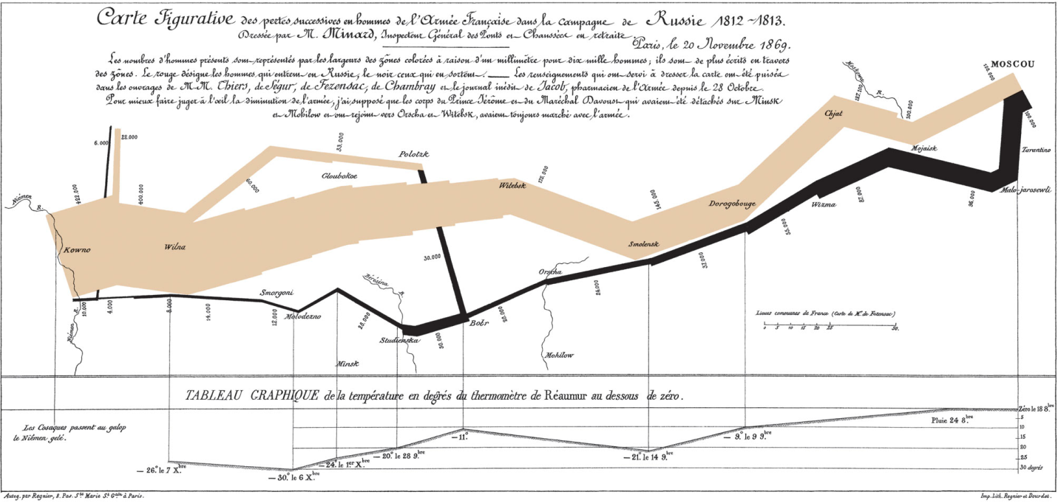
Decimation of Napoleon’s Army During the 1812 Russian Campaign
By Charles Joseph Minard
Arguably the most popular multi-dimensional chart

Slide 56

Application Case 2.6
Macfarlan Smith Improves Operational Performance Insight with Tableau Online
Questions for Discussion
What were the data and reporting related challenges Macfarlan Smith facing?
What was the solution and the obtained results and/or benefits?

Slide 57
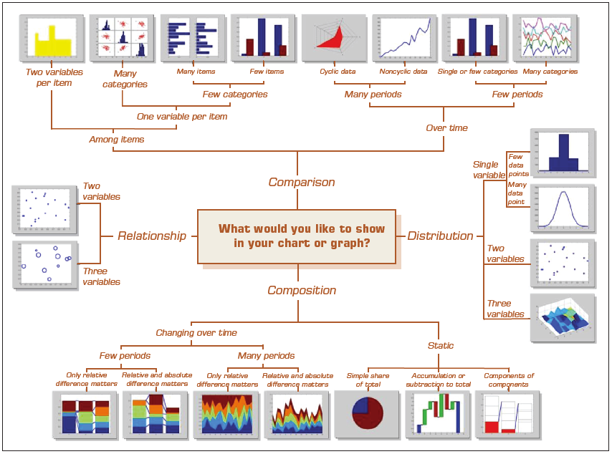
Which Chart or Graph Should You Use?

Slide 58
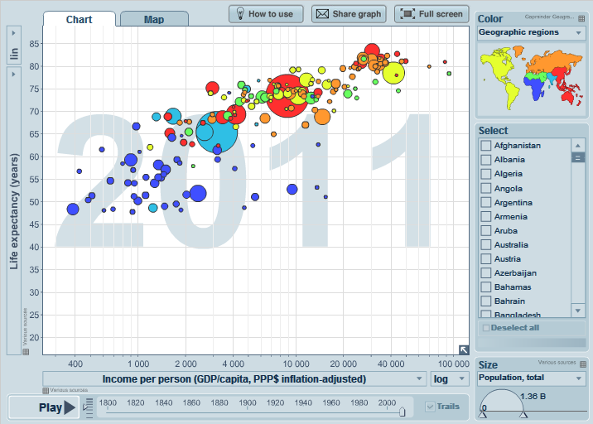
An Example Gapminder Chart Wealth and Health of Nations
See gapminder.o r g for Interesting animated examples

Slide 59
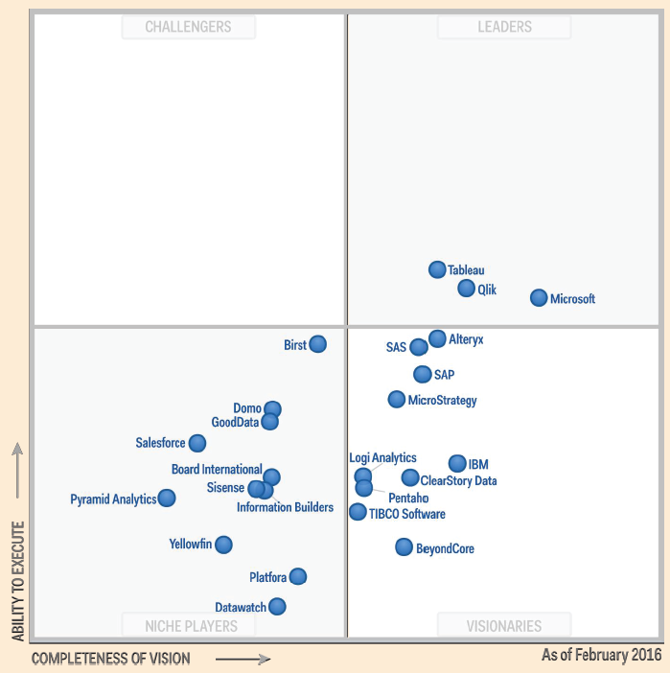
The Emergence of Data Visualization and Visual Analytics (1 of 2)
Magic Quadrant for Business Intelligence and Analytics Platforms (Source: Gartner.com)
Many data visualization companies are in the 4th quadrant
There is a move towards visualization

Slide 60
The Emergence of Data Visualization and Visual Analytics (2 of 2)
Emergence of new companies
Tableau, Spotfire, QlikView, …
Increased focus by the big players
MicroStrategy improved Visual Insight
S A P launched Visual Intelligence
S A S launched Visual Analytics
Microsoft bolstered PowerPivot with Power View
I B M launched Cognos Insight
Oracle acquired Endeca

Slide 61
Visual Analytics
A recently coined term
Information visualization + predictive analytics
Information visualization
Descriptive, backward focused
“what happened” “what is happening”
Predictive analytics
Predictive, future focused
“what will happen” “why will it happen”
There is a strong move toward visual analytics

Slide 62
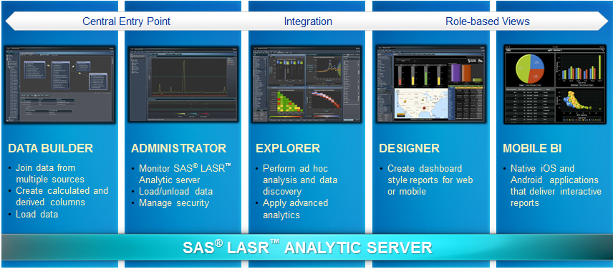
Visual Analytics by S A S Institute (1 of 2)
S A S Visual Analytics Architecture
Big data + In memory + Massively parallel processing + ..

Slide 63
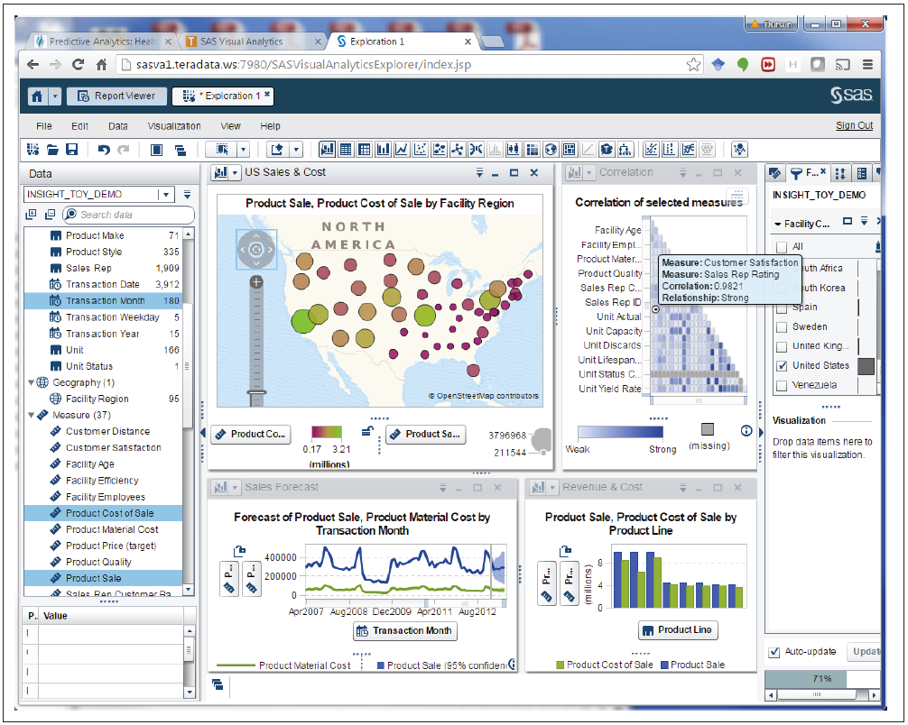
Visual Analytics by S A S Institute (2 of 2)
At teradatauniversitynetwork.com, you can learn more about S A S V A, experiment with the tool

Slide 64
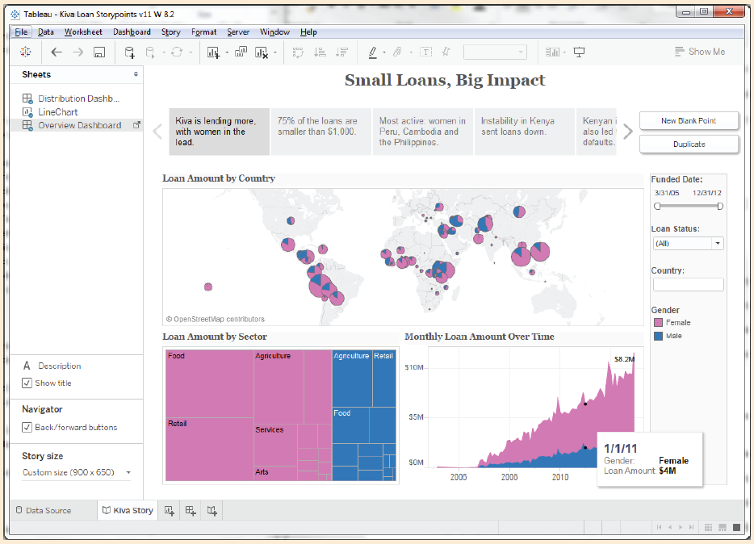
Technology Insight 2.3
Telling Great Stories with Data and Visualization

Slide 65
Performance Dashboards (1 of 4)
Performance dashboards are commonly used in B P M software suites and B I platforms
Dashboards provide visual displays of important information that is consolidated and arranged on a single screen so that information can be digested at a single glance and easily drilled in and further explored

Slide 66
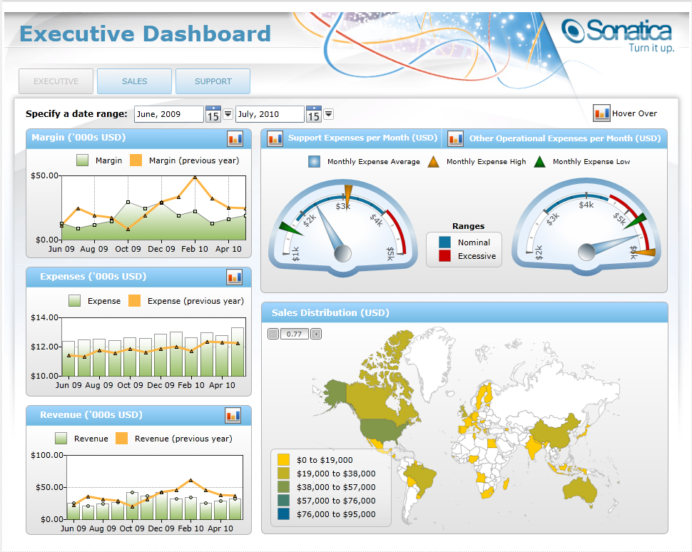
Performance Dashboards (2 of 4)

Slide 67
Application Case 2.7
Dallas Cowboys Score Big with Tableau and Teknion
Questions for Discussion
How did the Dallas Cowboys use information visualization?
What were the challenge, the proposed solution, and the obtained results?

Slide 68
Performance Dashboards (3 of 4)
Dashboard design
The fundamental challenge of dashboard design is to display all the required information on a single screen, clearly and without distraction, in a manner that can be assimilated quickly
Three layer of information
Monitoring
Analysis
Management

Slide 69
Performance Dashboards (4 of 4)
What to look for in a dashboard
Use of visual components to highlight data and exceptions that require action
Transparent to the user, meaning that they require minimal training and are extremely easy to use
Combine data from a variety of systems into a single, summarized, unified view of the business
Enable drill-down or drill-through to underlying data sources or reports
Present a dynamic, real-world view with timely data
Require little coding to implement, deploy, and maintain

Slide 70
Best Practices in Dashboard Design
Benchmark K P I s with Industry Standards
Wrap the Metrics with Contextual Metadata
Validate the Design by a Usability Specialist
Prioritize and Rank Alerts and Exceptions
Enrich Dashboard with Business-User Comments
Present Information in Three Different Levels
Pick the Right Visual Constructs
Provide for Guided Analytics

Slide 71
Application Case 2.8
Visual Analytics Helps Energy Supplier Make Better Connections
Questions for Discussion
Why do you think energy supply companies are among the prime users of information visualization tools?
How did Electrabel use information visualization for the single version of the truth?
What were their challenges, the proposed solution, and the obtained results?

Slide 72
End of Chapter 2
Questions / Comments

Slide 73

Copyright

